Slide 1

Team Members:
Jairo Arreola (jaa0019@uah.edu)
Daniel Burris (dab0021@uah.edu)
Komlan Maglo (kmm0048@uah.edu)
Adam Walters (atw0015@uah.edu)
CPE 495-01 Computer Engineering Design I
Electrical and Computer Engineering
The University of Alabama-Huntsville

Slide 2

Project Summary
Android App that allows for quick navigation around the buildings on the UAH Campus.
Notes:
Our goal was to develop an Android App that allows for quick navigation around the UAH Campus. You would be able to enter your class information and receive a drawn out path showing you how to get to the classroom.

Slide 3
The Team
Adam Walters - Project Lead. Navigation Designer.
Jairo Arreola – Utility Programmer. Navigation Implementer.
Daniel Burris - Database Manager. GUI Designer Assistant.
Komlan Maglo - Graphical Interface Designer.

Slide 4
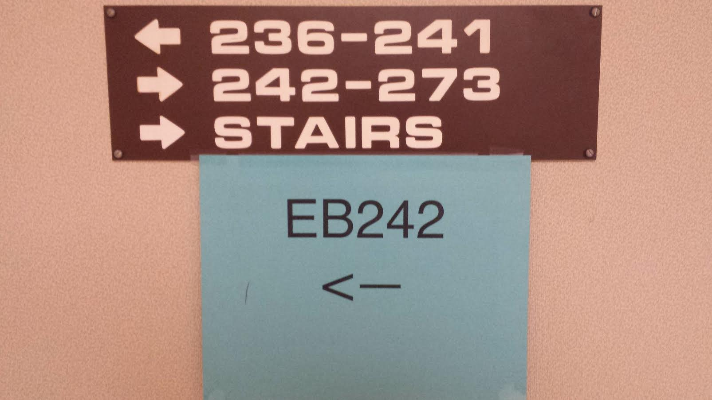

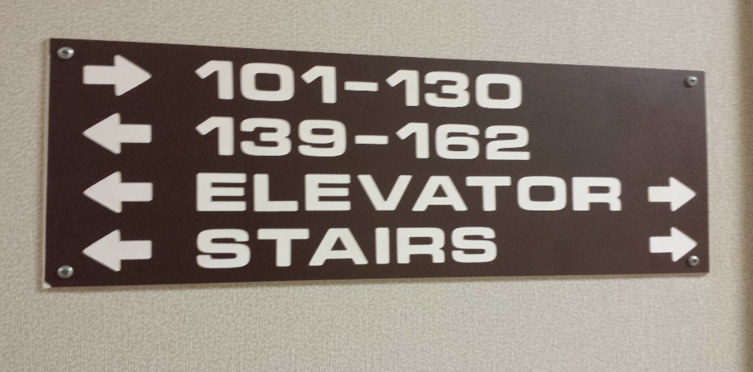

The Need for this Project
Scenario 1
Scenario 2

Slide 5
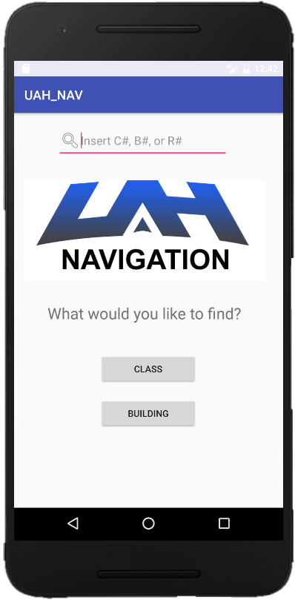
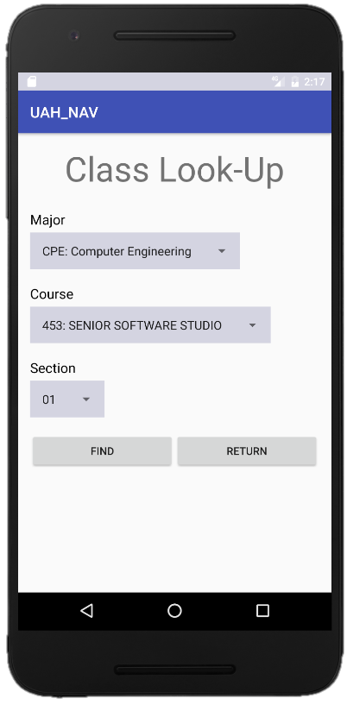
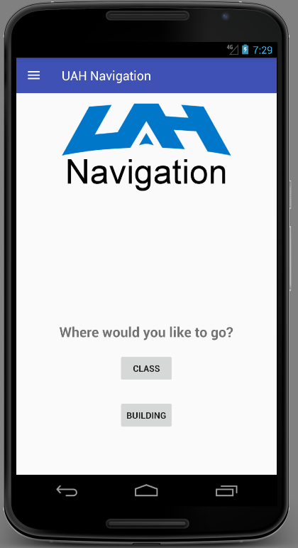
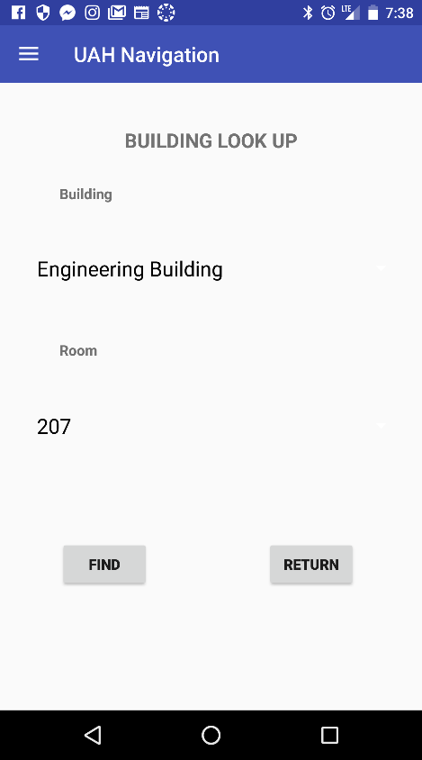
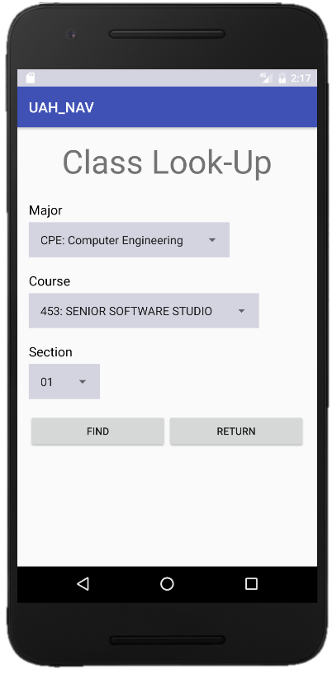
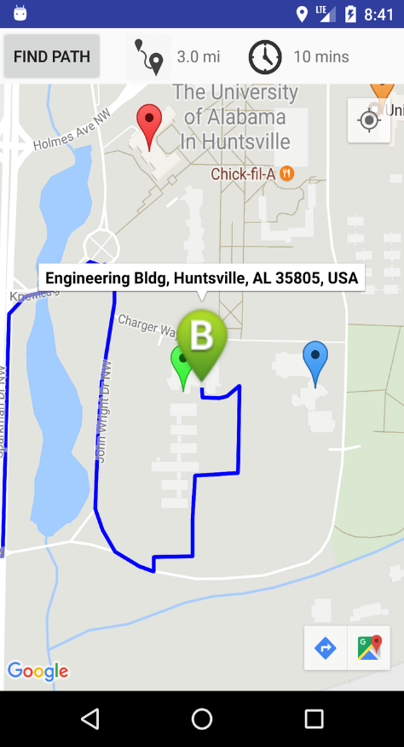
Our Solution
Building Selected
212
Time
Find
02:20 pm ▼

Slide 6
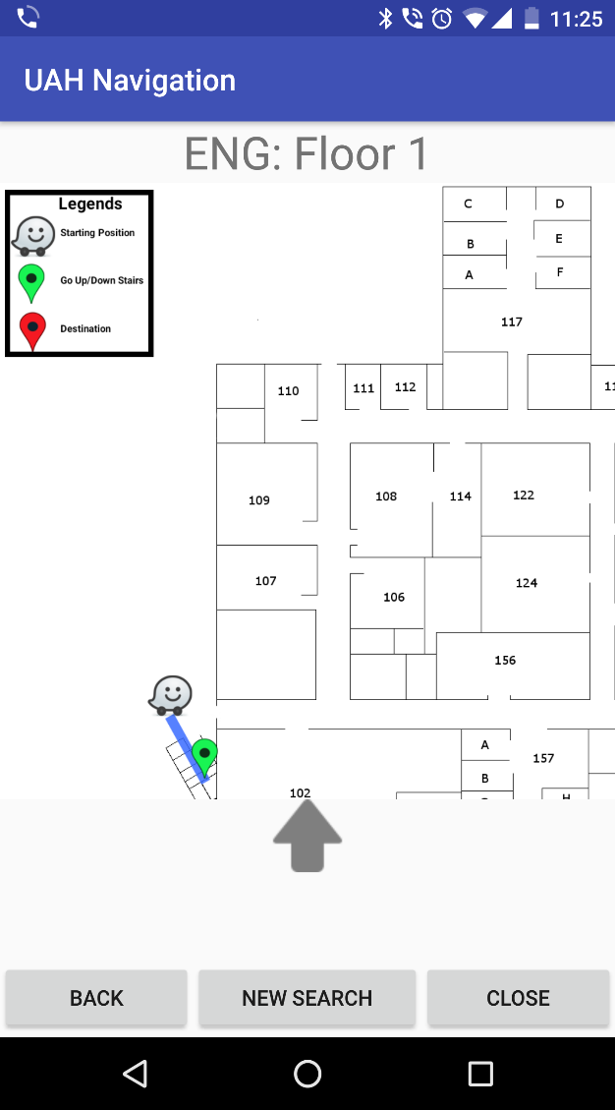
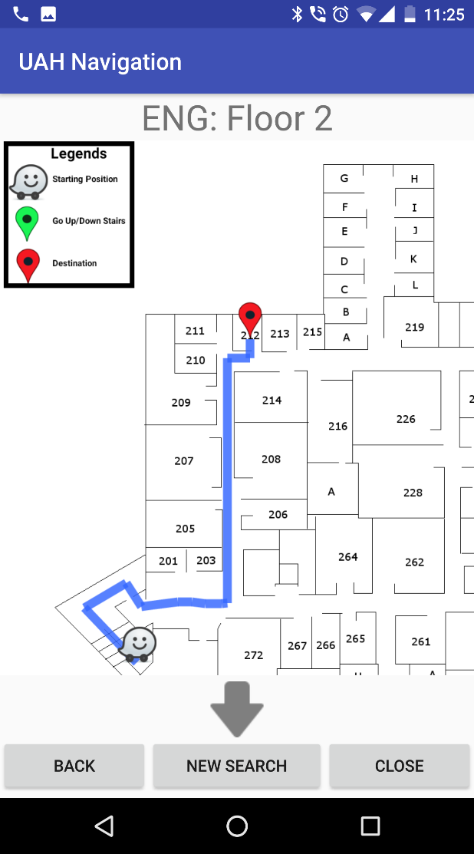

Slide 7
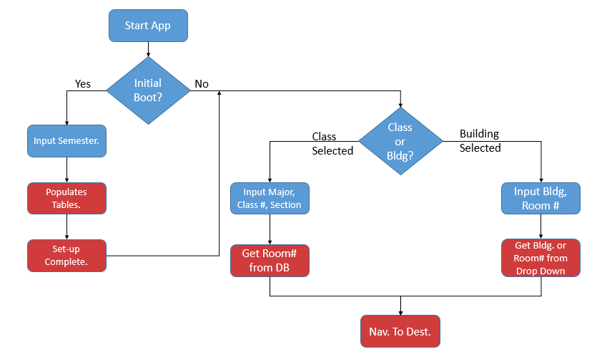
System Design Description
* Blue represents User prompts. Red represents Application Prompts.

Slide 8
Marketing Requirements
Low Data Usage.
Low Power Consumption.
Exterior Navigation using Google Maps’ API.
Quick Navigation of App’s GUI. (3-Tap Design)
Provides Floor Plans of Buildings.

Slide 9
Engineering Requirements
SQLite3 Database
Easily updatable.
Minimum size of 32KB
Custom API for access and entry.
Android API 16.
API 16 supports up to 98% of current android phones. (02/2017, Android’s Global Distribution Chart)
Interior Navigation
Graph-Based Approach
Abundance of search algorithms.
Static for each floorplan.
Base case: Engineering Building.

Slide 10
Market & Competition
No direct competition.
Other Navigational Apps do not direct users to specific rooms.
None are specific to the UAH Campus.
Student Initiated/Funded.

Slide 11

Existing Projects
UAH Events App
Features
Student Event Calendar
UAH Campus Map
Basic Student Life Information
Hosted by Student Affairs.

Slide 12
Demo

Slide 13
Actual Demo

Slide 14
Our Approach to the GUI
Simple, Quick User Interface
The App is self-explanatory and concise with the information that it needs.
3-Tap Design
User gets their desired result in 3 screen transitions or less.
Busy Graphics
App produces labelled loading bars.

Slide 15
Our Approach to the GUI
Dynamic Resolution
The App adjusts its resolution to fit the user’s device.

Slide 16
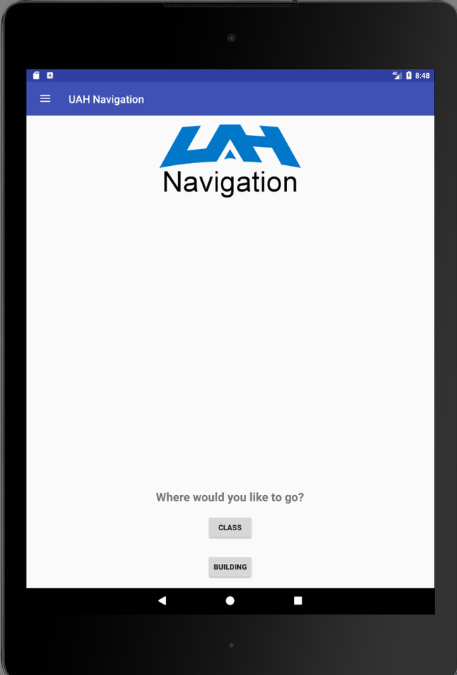
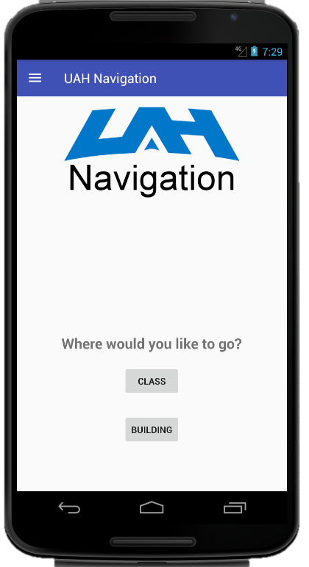

Slide 17
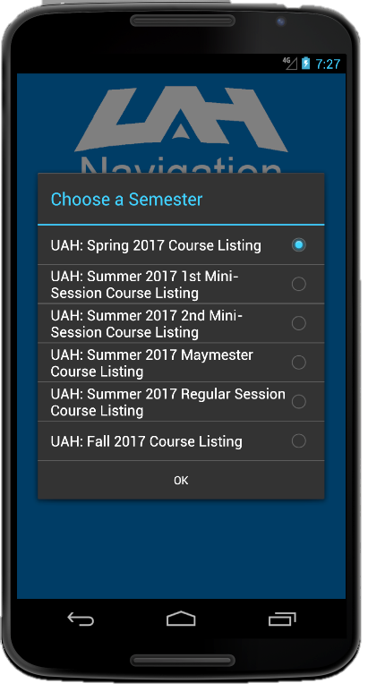

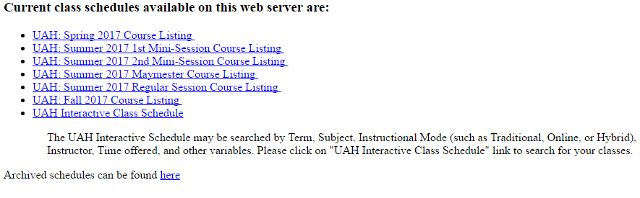
Our Approach to the Information Gathering
Webscrapping
Parses HTML page to gather class information.
Sends info to Database to be stored.

Slide 18
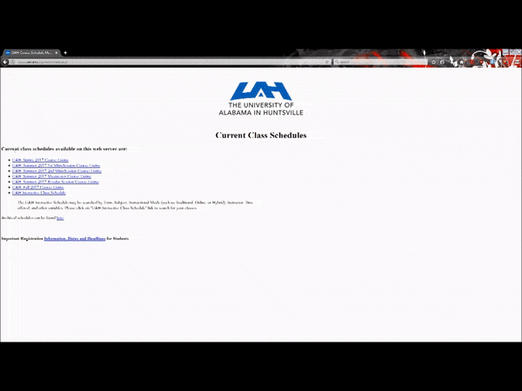
Our Approach to the Information Gathering

Slide 19
Our Approach to the Database
SQLite 3 Database
Compact, Easy to Use, and Stored Locally.
[Include a new slide with Database Graph?]

Slide 20
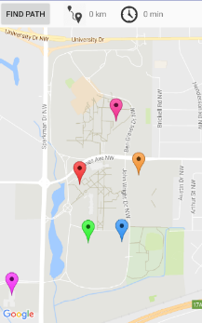

Our Approach to the Exterior Navigation
Google Maps API
Expanded upon. Added Custom markers around buildings to know where the user entered.

Slide 21
Our Approach to the Interior Navigation
Shortest Path
Dykstra’s Algorithm
Adjacency Matrix Based
Fairly Quick Results
Simple to Implement

Slide 22
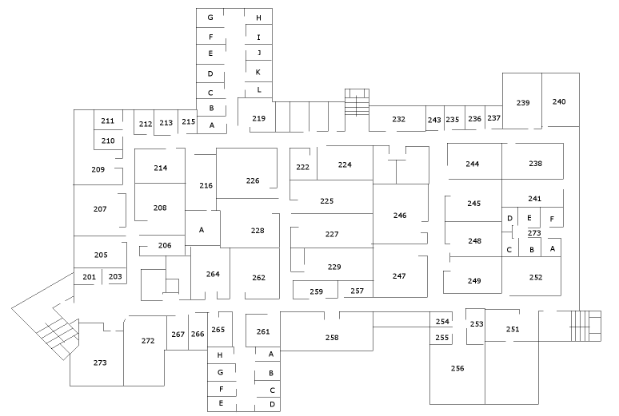
Our Approach to the Interior Navigation
Floor Plans
App pulls up another screen with a floorplan of the building. Arrows allow user to traverse the floors of the building.

Slide 23
Our Approach to the Interior Navigation
Path Drawing
Android Studio’s Canvas Object
Allows images to be drawn on, and then displayed.
Zoom Event Handlers
Allows user to zoom in and out on the Canvas Object.

Slide 24
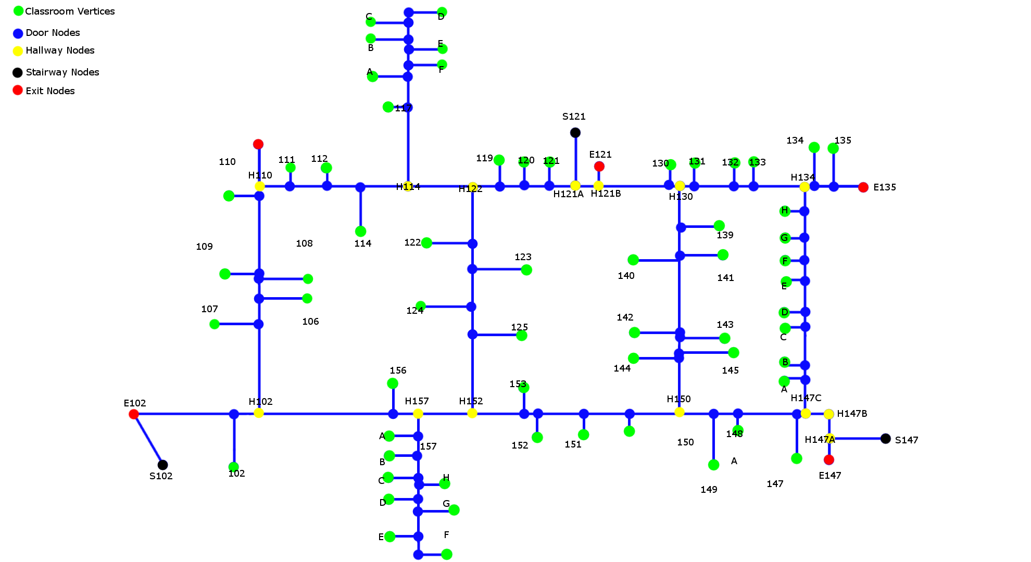
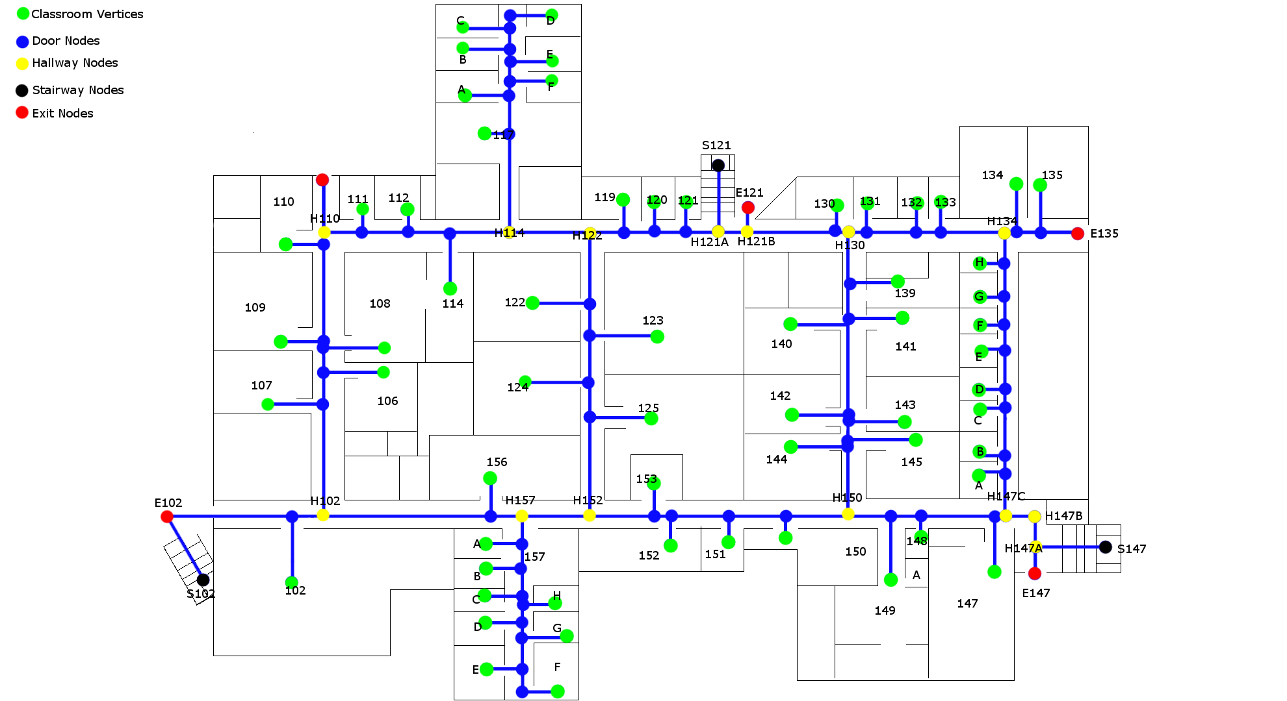
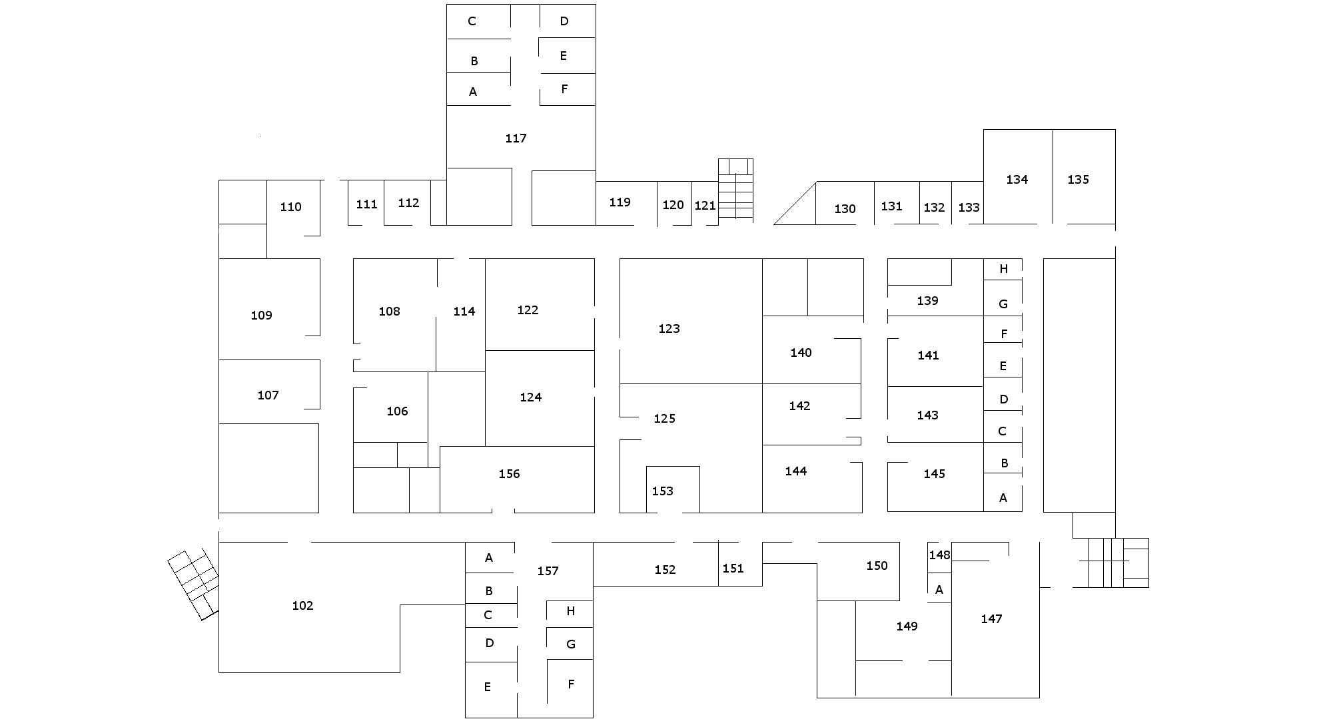
Our Approach to the Interior Navigation
Graph-Based

Slide 25
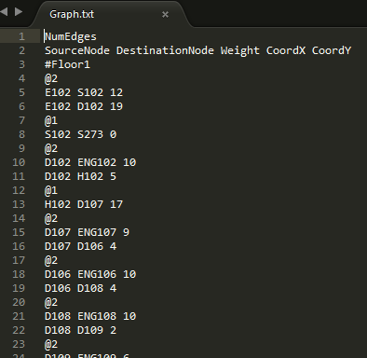
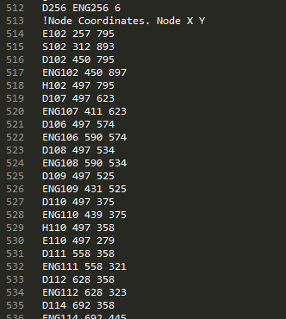
Our Approach to Graph Generation
Graph Text File

Slide 26
Testing
Unit Tests (JUnit)
Classes.
Static Methods.
Acceptance Tests (Espresso)
Button Functionality Testing.
Resolution Testing.
GPS Location Testing.
Using Power Mockito and Mockito Library
Field Testing
Emulation

Slide 27
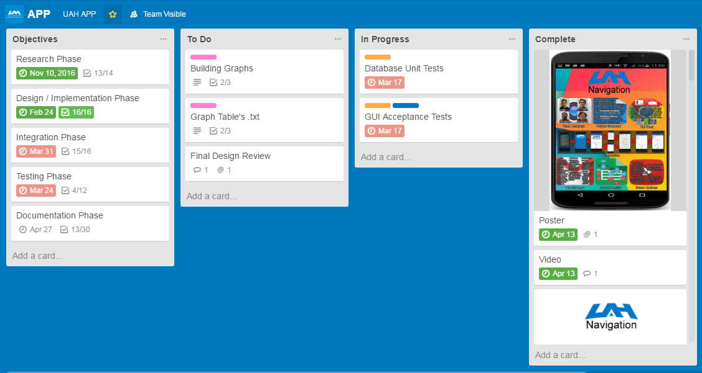
Project Task Manager
https://trello.com/b/iZJ03jLi/app

Slide 28
Cost Estimation
No Cost.
Free IDE and Development Kit.
Future Costs
Google Play Store fee ($25)
Total Estimated Individual Labor Hours
120 Hours
Total Estimated Meeting Hours
100 Hours

Slide 29
Final Project Deliverables
Fully functional indoor UAH Engineering and Material Science Navigational App for Android Devices.
Works with a vast majority of Android Devices.
Easily-Expandable Navigation App.
Documentation
User Guide.
Developer Guide.

Slide 30
Lessons Learned
Creating an App from scratch is a lot of work.
Test-Driven Development takes quite a bit of time to follow.
Busy workloads are hard to overcome.
Most Importantly, Never, never rely on outside sources to give you important information (looking at you UAH architect)

Slide 31
Future Updates
Index Remaining Buildings
Complete graphs for the remaining buildings on campus.
Handicap Accessibility Design
Add an additional graph that prioritizes elevators and ramps.
Refine Exterior Navigation
Add waypoints to Google Maps API.
Driving Tab that leads to parking lots.
Walking Tab that leads user along sidewalks.
Notes:
(Regarding Handicap) However, this would require a redesign of the current interior navigation.
(Regarding Data Mine) However, this would require a different Database methodology. Also, we would run into privacy concerns with the tracking of users.

Slide 32
Future Updates
iOS Implementation
Build an iOS-compatible version of UAH Navigation.
Server-Based Approach
Add Server-Based Database, MySQL.
Allow route to be passed back to the client.
Data Mine users for better path optimization.
Banner Integration
App is connected to student’s banner account.
Notes:
These are possible update ideas for anyone who picks up the app after us. Whether its [insert UAH Department Name], or a future senior design student. If any of you are interested, you can let us know after the presentations, or let Dr. Wells know that you are interested.

Slide 33
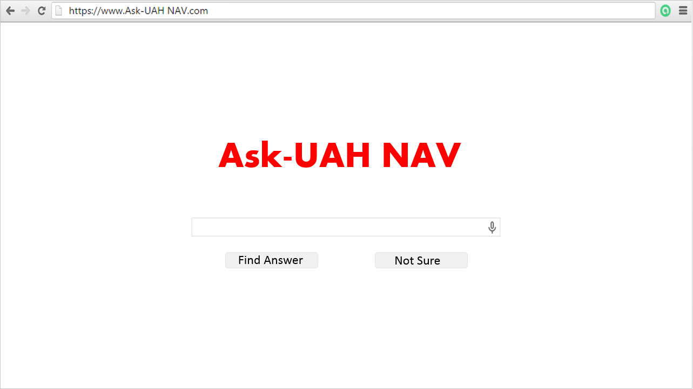
Questions?

